Slide 1
HOME ACTIVITIES FOR THE WEEK
BY: MISS ORDA
TODDLER C

Slide 2
With schools closed and families at home, it’s easy to slip into the summer vacation or snow day mindset. As tempting as it may be to sit in front of the television for movie marathons or series binges, it's important to keep kids engaged in a healthy way while school’s out..
Sticking to their regular routine as much as possible will keep them busy and focused also, it will make the day go by faster.
While on quarantine at home, reducing the spread of the virus is good to wash hands often to reduce the risk of getting germs and getting sick.. kids love washing their hands.!!! Clean and disinfect frequently touched objects or surfaces.
Wash hands with soap and water for at least 20 seconds.

Slide 3
Our routine in the day looks something like this:
Breakfast
Potty
Circle time
Exercise/ outdoor activity
Potty
Activity 1 (puzzles or science project)
Activity 2 (sensory or arts and craft)
Lunch
Nap
Wake up/ potty
Snack
Afternoon circle time / musical instruments
Potty
Activity 3 ( pretend play or reading time)
Activity 4 (sensory or puzzles)

Slide 4
CIRCLE TIME
Good Morning Song: https://www.youtube.com/watch?v=r7Bpn8yXb5o
Ask: How do you feel today?
Day of the week: https://www.youtube.com/watch?v=3tx0rvuXIRg
Month of the year: https://www.youtube.com/watch?v=rMhZXxQP5fo
Weather: https://www.youtube.com/watch?v=rD6FRDd9Hew
Season: https://www.youtube.com/watch?v=8ZjpI6fgYSY
ABC/ Letter sound: https://www.youtube.com/watch?v=U3S3OX6HQm4

Slide 5
Other fun songs
Fish song: https://www.youtube.com/watch?v=Cg-wnQKRHTs
We are the dinosaurs: https://www.youtube.com/watch?v=82ooOpJLzr8
Bubble chant song: https://www.youtube.com/watch?v=W3YHu0MvhN8
Sleeping bunnies: https://www.youtube.com/watch?v=BHcFQ9gaMF4
Bum Chika boom: https://www.youtube.com/watch?v=RL1pANQq1j4
Count to 100 song: https://www.youtube.com/watch?v=0TgLtF3PMOc&t=85s

Slide 6
ABC Freeze Song: https://www.youtube.com/watch?v=rcHgaF9kCZY
Head, Shoulders, Knees & Toes: https://www.youtube.com/watch?v=RuqvGiZi0qg
The Ants Go Marching: https://www.youtube.com/watch?v=Pjw2A3QU8Qg
There’s a whole in the bottom of the sea: https://www.youtube.com/watch?v=R1Qn2bcZRTo
We all go traveling by: https://www.youtube.com/watch?v=cSw50Jw0H34
The Journey Home from Grandpa’s: https://www.youtube.com/watch?v=wKcrsv_t8Ko
Driving my tractor song: https://www.youtube.com/watch?v=Lj_odhwo81s

Slide 7
BOOKS TO LISTEN
THE GINGERBREAD MAN: https://www.youtube.com/watch?v=pckuS--UlV4
COUNT THE MONKEYS: https://www.youtube.com/watch?v=qOq5Ru81ezg

Slide 8
MONDAY
SCAVENGER HUNT: Have the kids go outside and collect outdoor objects and glue them to a poster board
SCIENCE SENSORY (FAKE SNOW ARTS AND CRAFT): https://thepurposefulnest.com/how-make-fake-snow/
PUTTING TOGETHER HUMPTY DUMPTY: https://iheartcraftythings.com/humpty-dumpty-craft.html
CUT OUT A PIG AND PAINT IT: Have the kids color the pig using brown paint using their fingers or brush making a muddy pig

Slide 9
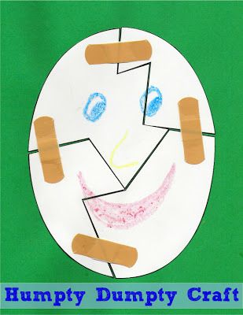
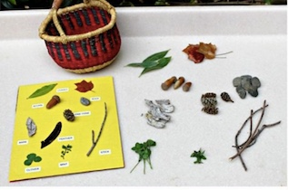
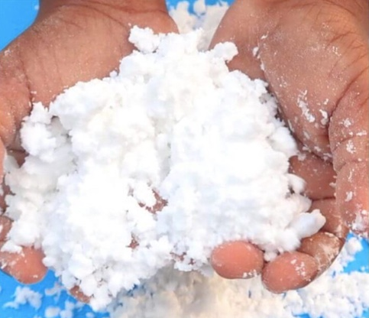
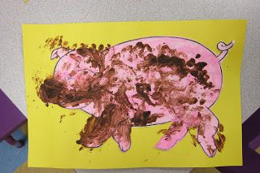

Slide 10
TUESDAY
TEXTURE ACTIVITY: Gather different texture objects, with paper, pencil and scissors to cut out a hand and glue the objects to each finger in the hand print. Do as many as you’d like. Kids enjoy textures.
SKITTLE/ M&M SCIENCE ACTIVITY: https://www.funwithmama.com/easy-skittles-rainbow-kids-candy-science-experiment/
MEMORY GAME WITH FLASH CARDS: https://www.freepik.com/premium-vector/memory-game-kids_5768879.htm
ANIMAL TRACKS: Gather toy animals and paint of the kids choice to make the animal print.

Slide 11
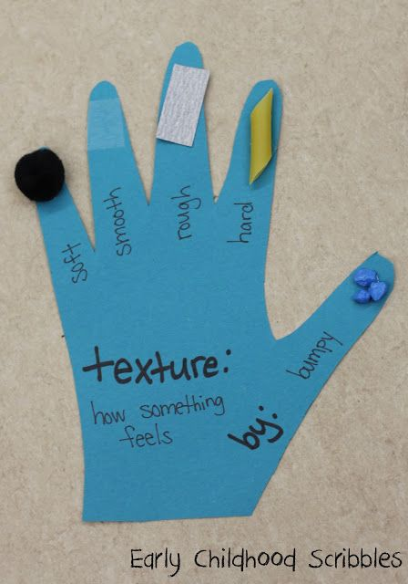
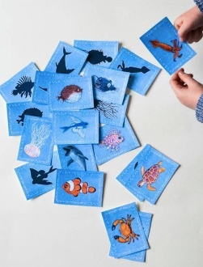
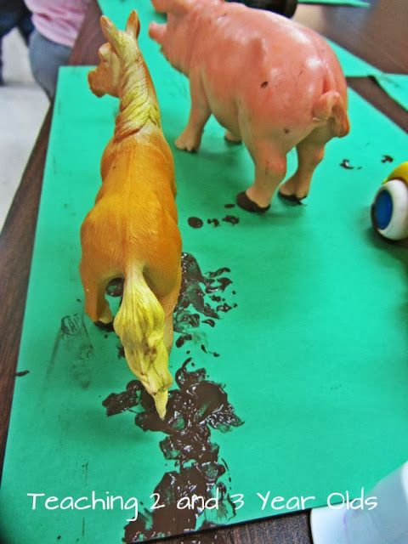
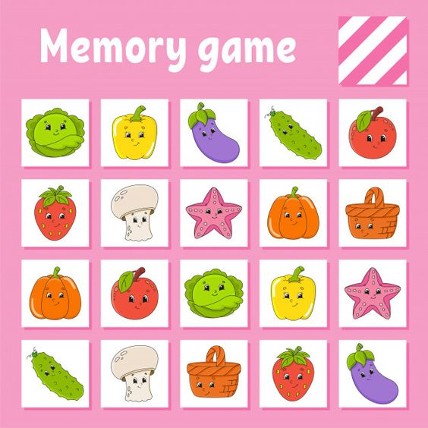

Slide 12
WEDNESDAY
SINK OR FLOAT ACTIVITY: Gather light and heavy objects and ask if the item will sink to the bottom or it would float
INDOOR SCAVENGER: In rice put small objects and put the child to look for a specific item you are asking to take out
RAINBOW FISH: Rainbow color paint and celery sticks
BUILDING CHALLENGE : Marshmallow and toothpicks. You can even use gumdrops

Slide 13
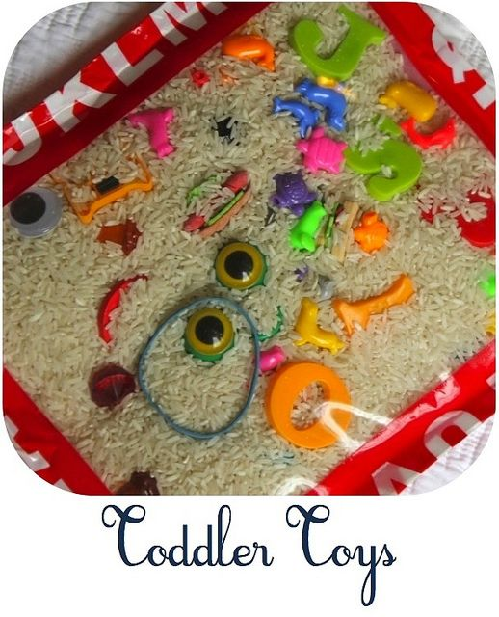
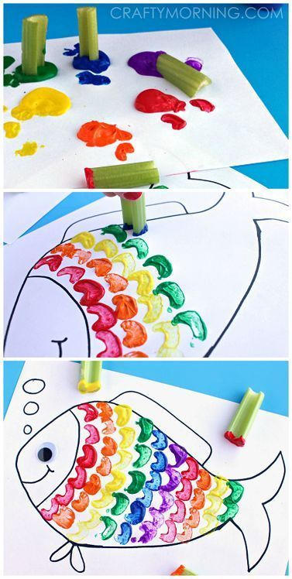
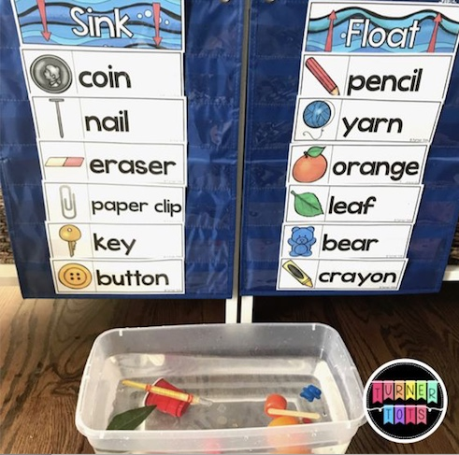
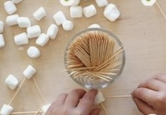

Slide 14
THURSDAY
MAKING SLIME: https://especiallyeducation.com/winter-sensory-science/
SCOOP AND TRANSFER: Gather cotton balls, a spoon, a bowl. Allow the child to pick up the cotton balls with the spoon in the bowl.
MAGIC MILK EXPERIMENT: https://lemonlimeadventures.com/magic-milk-toddlers-preschoolers-palmolive-dish-soap-palmolive25ways-cbias/#_a5y_p=2291040
AMAZING BUBBLE ART: https://earlylearningideas.com/art-activities-for-kids-bubble-painting/

Slide 15
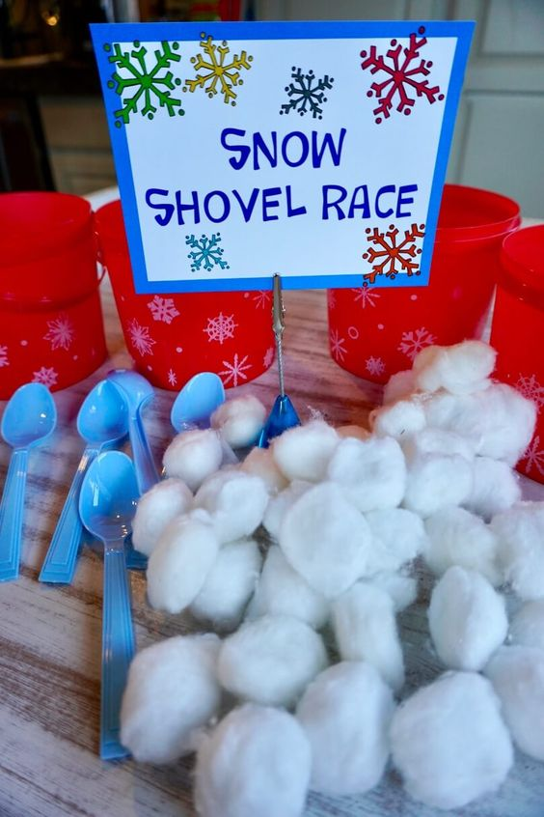
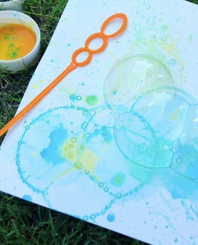
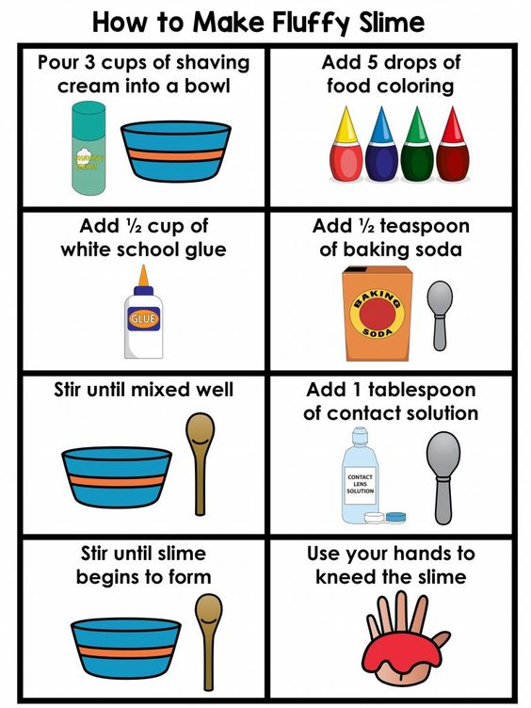
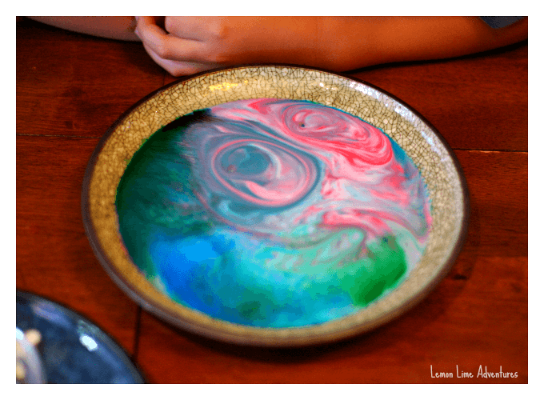

Slide 16
FRIDAY
DINOSAUR SENSORY BIN: Gather a bin, dinosaurs, branches and other objects to make a pretend dinosaur Jurassic world
LEAF PAINT PRINTS: https://www.growingajeweledrose.com/2019/08/leaf-painting-for-kids_28.html?utm_medium=social&utm_source=pinterest&utm_campaign=tailwind_tribes&utm_content=tribes&utm_term=809653380_33874722_240565
SNOW STORM IN A JAR: https://www.mombrite.com/snowstorm-in-a-jar/
SHAPES MATCHING GAME: https://www.supplyme.com/products/free-printable-shapes-matching-memory-game-A7947

Slide 17
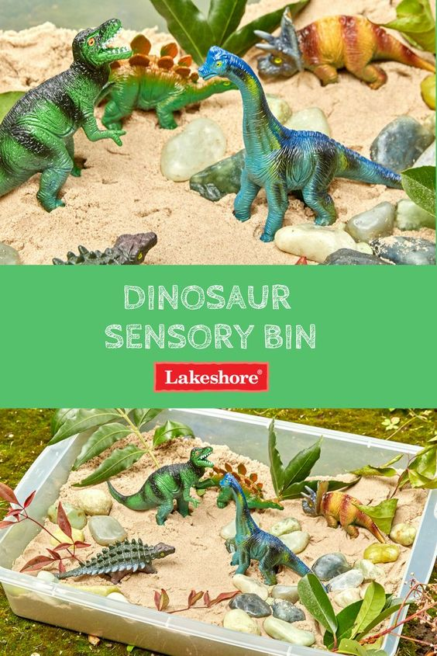
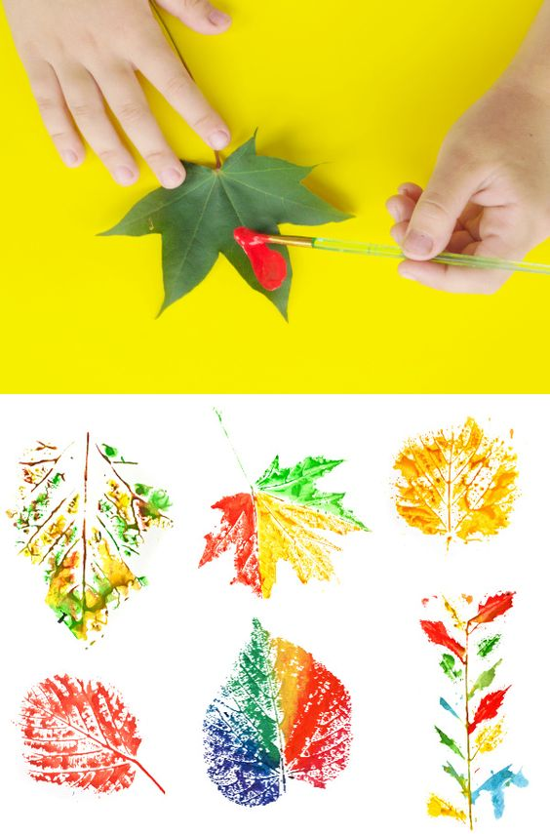
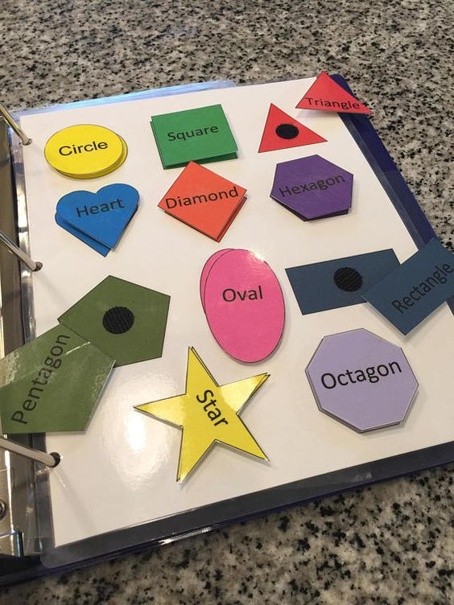
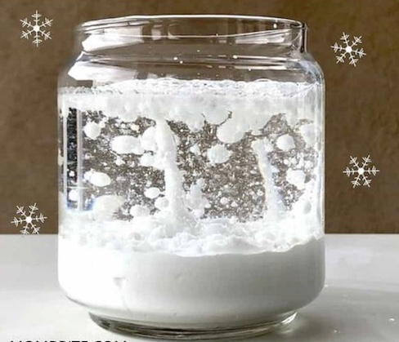

Slide 18
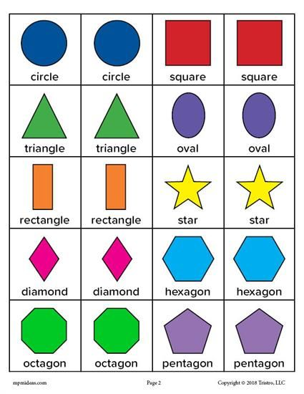

Slide 19
OTHER ACTIVITIES
INDOOR SCAVENGER HUNT
DANCING POPCORN: https://everydaychaosandcalm.com/how-to-make-dancing-popcorn/
OIL AND WATER SENSORY: https://everydaychaosandcalm.com/oil-and-water-sensory-bag/
MAKING SOAP SOLUTION FOR BUBBLES: https://www.instructables.com/How-to-Make-Bubbles/?linkId=68928367
PINECONE EXPERIMENT: https://lemonlimeadventures.com/why-pine-cone-science-experiment-for-kids/#_a5y_p=2918325
SNOWMAN ACTIVITY: https://www.raisingdragons.com/build-a-snowman-winter-sensory-bag/
DISH SOAP EXPERIMENT: https://mashable.com/2013/10/09/science-experiments-kids/#m!490e

Slide 20
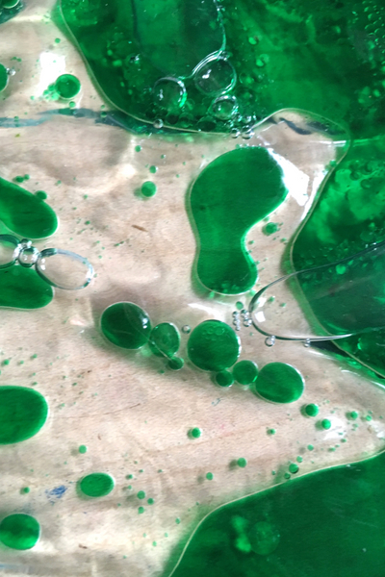
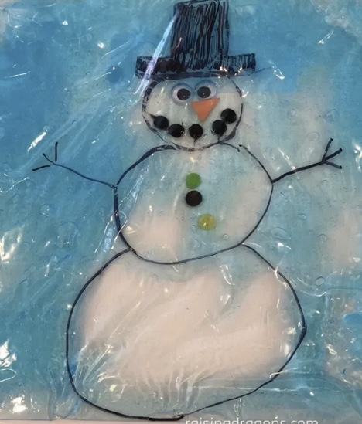
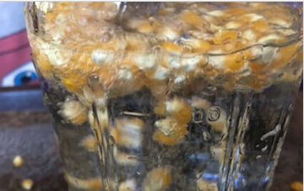
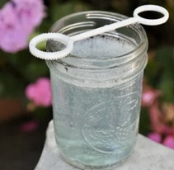
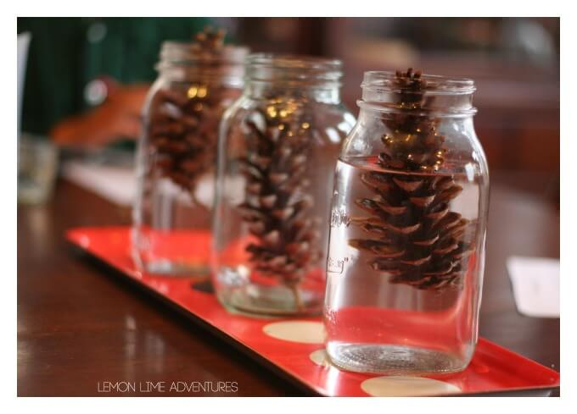
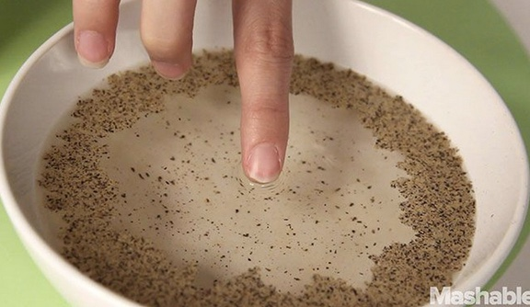

Slide 21
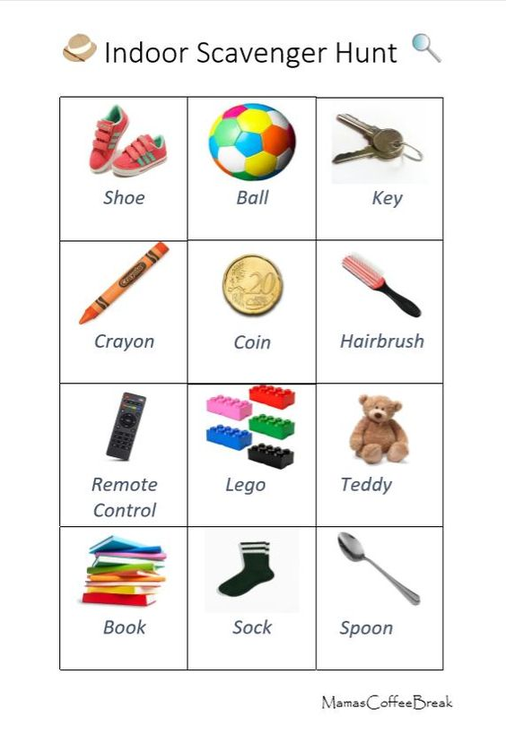

Slide 22
THE END!!!
HOPE TO SEE YOU SOON :)

